Slide 1

Investigating periods of increasing interest rates for the S&P 1500
DATA ANALYTICS AND ARTIFICIAL INTELLIGENCE - EM1405
by Professor Andrea Albarelli
by Luca Reichelt, 999786
Github

Slide 2
Table of Contents
Outline
Data
Machine Learning
Conclusion
Sources

Slide 3
Outline

Slide 4
1. Outline
central banks aim to keep inflation at a stable rate of approx. 2% per year
economic shocks/risky fiscal policy lead to unexpected hikes in consumer prices and therefore inflation
aiming to stabilize inflation, central banks decrease the incentives for banks and companies to borrow money by steadily increasing their rates to straddle liquidity and calm price hikes
as exemplified by the following papers, there is no clear census on what stocks/assets perform better in these times of decreasing liquidity or even if they perform good/bad at all

Slide 5
1. Outline
“[Gold is generally assumed to be a great hedge against (long-term) inflation.]”
- see Ghosh, Dipak, et al. "Gold as an inflation hedge?." Studies in Economics and Finance 22.1 (2004): 1-25.
“In terms of investment policy implication, our results suggest that US investors will have a good hedge against inflation by holding stock asset and real estate, and not by holding gold.”
- see Salisu, Afees A., Ibrahim D. Raheem, and Umar B. Ndako. "The inflation hedging properties of gold, companies and real estate: A comparative analysis." Resources Policy 66 (2020): 101605.
“[C]orporate profitability is the highest when inflation is modest (0-4 percent), and it is very low when inflation is very low (deflation) or very high (over 10 percent).”
- see Park, Sangkyun. "companies as a Hedge against Inflation: Does Corporate Profitability Keep Up with Inflation?."

Slide 6
1. Outline
“[There is e]vidence of a positive relationship between current stock market returns and current inflation. This result confirms that stock returns act as a hedge against inflation.”
- see Choudhry, Taufiq. "Inflation and rates of return on stocks: evidence from high inflation countries." Journal of International Financial Markets, Institutions and Money 11.1 (2001): 75-96.
“[I]nvestors are better off by holding a portfolio of stocks with higher long-run betas as part of asset selection and allocation strategy. Stocks that outperform inflation tend to be drawn from the energy and industrial sectors. ”
- see Bampinas, Georgios, and Theodore Panagiotidis. "Hedging inflation with individual US companies: A long-run portfolio analysis." The North American Journal of Economics and Finance 37 (2016): 374-392.

Slide 7
1. Outline
Findings
gold seen as good long-term investment, but not short-term
profits in general lower for higher rates
evidence of positive relationship between inflation and stock returns
risky assets and those of energy/industry sector seem to be better
Resulting research questions
Do companies with certain features perform better? Which features are the most significant ones?
Can better performing companies be predicted?

Slide 8
2. Data

Slide 9
2. Data
Basics
S&P 1500 members included at start of period
Start: first effective fed rate increase
End: first effective fed rate stagnant/decrease
Comparative Data (monthly):
S&P 500
Nasdaq
Gold
Crude Oil
CPI (Consumer Price Index)
Rate of Unemployment
Notes:
The effective federal funds rate is essentially determined by the market but is influenced by the Federal Reserve through open market operations to reach the federal funds rate target
Net debt is calculated by subtracting a company's total cash and cash equivalents from its total short-term and long-term debt.

Slide 10
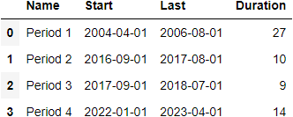
2. Data
Periods

Slide 11
2. Data
Weaknesses
rather short periods (9 months minimum)
rather few periods; limited data possibilities (checking for rolling improvement with was initial idea, impractical due to only 3(or 4) periods)
current period hasn’t concluded
no comparison of results to random timeframes (stocks always performing better than other securities/assets?)
no consideration of initial crisis or crisis within period
Notes:
Due to bad/no membership data before 2000, limited to short timeframe

Slide 12
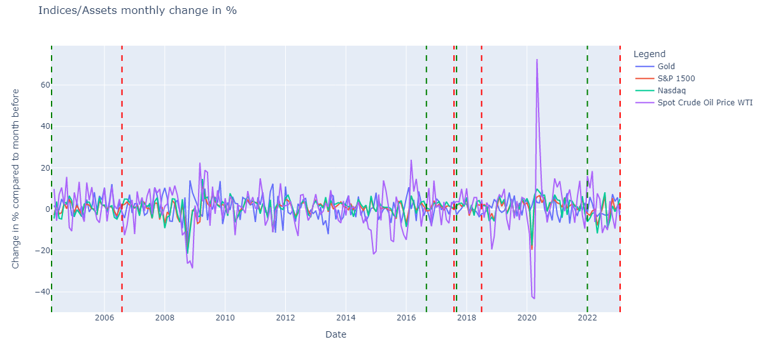
2. Data

Slide 13
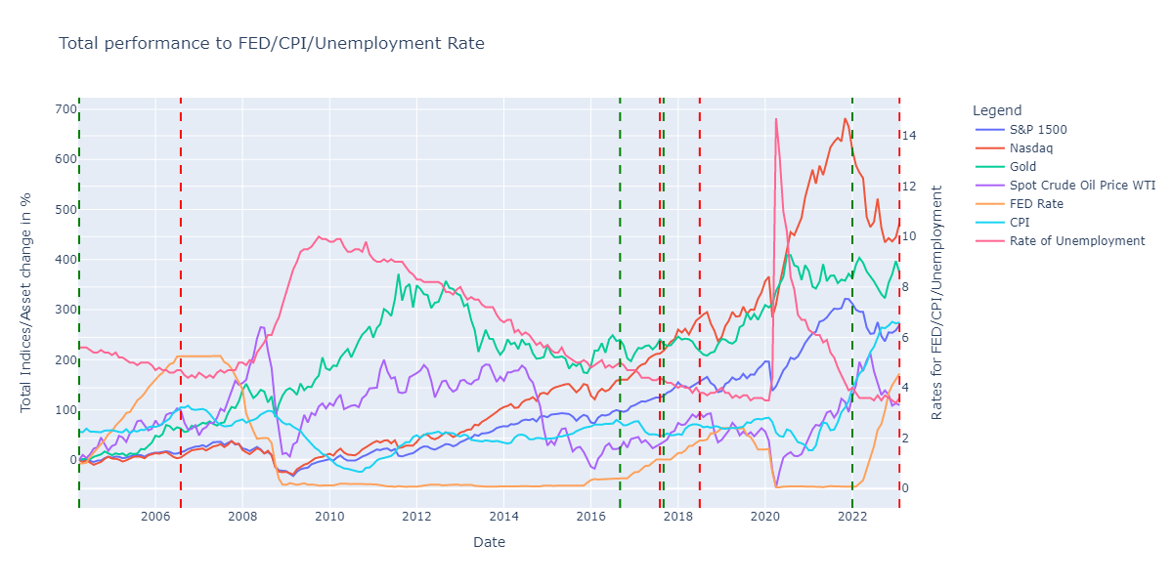
2. Data

Slide 14
2. Data
Target & Features
Target: Performance of company by change in Market Cap:
“Outperformed” for higher than mean
“Not Outperformed”
Features:
Common figures
Market Cap
Sector
Revenue T12M
Number of Employees
Profitability Ratios
EPS T12M - Profit per Share
P/E - Price to EPS
Risk Ratios
Net Debt - Ability to pay off debt
Sharpe M - Return to Risk
Beta M - Compared Volatility
Revenue per Employee
Notes:
The effective federal funds rate is essentially determined by the market but is influenced by the Federal Reserve through open market operations to reach the federal funds rate target
Net debt is calculated by subtracting a company's total cash and cash equivalents from its total short-term and long-term debt.

Slide 15
2. Data
Cleaning & Preprocessing
transforming to correct data-types
dropping all observations with nan values
creating dummies (one-hot encoding) for the sector feature
adding a new feature: Revenue per Employee
adding the base for the target feature: Market Cap_perf
dropping Price and Market Cap_last
Notes:
Due to bad/no membership data before 2000, limited to short and few timeframes

Slide 16
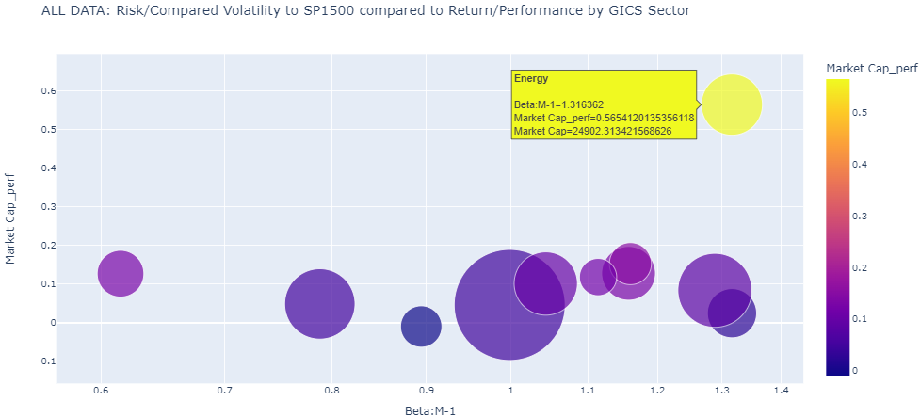
2. Data
Notes:
Due to bad/no membership data before 2000, limited to short timeframe

Slide 17
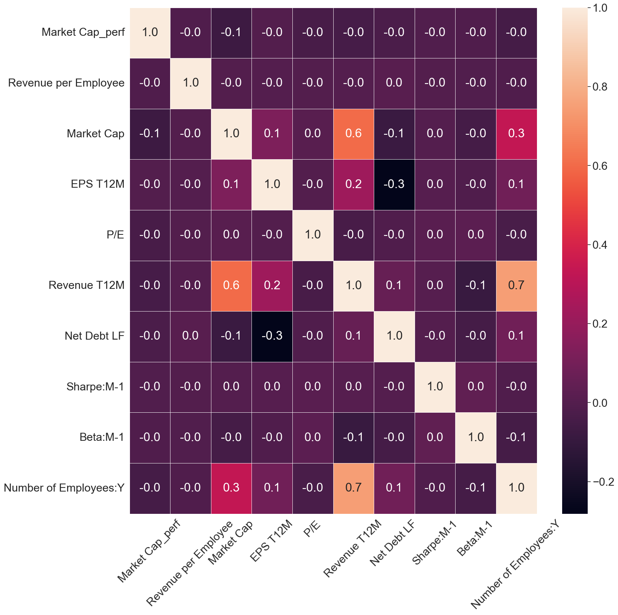
2. Data
Notes:
Due to bad/no membership data before 2000, limited to short timeframe

Slide 18
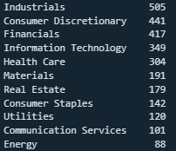
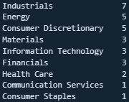
2. Data: “Top 10”
All
Top 10
Top 10 performing companies for all concluded periods
Energy sector strongly overrepresented
Real Estate and Utilities are both not once in Top10

Slide 19
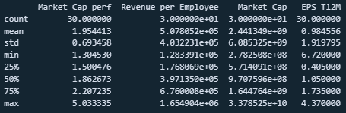
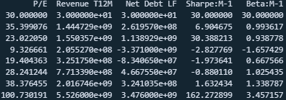
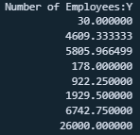
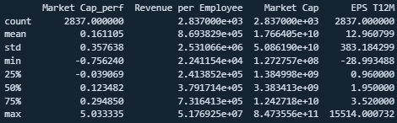
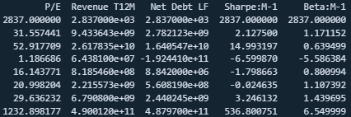
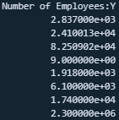
2. Data: Top 10 vs. All
Top 10
All

Slide 20
3. Machine Learning
Notes:
https://github.com/luca1308/Investigating_periods_of_increasing_interest_rates_for_the_S-P_1500

Slide 21
3. Machine Learning
target label is determined:
companies with a higher return than the mean are labeled “Outperformed”
companies with a lower return than the mean or an equal return are labeled “Not Outperformed”
differentiation between three data cases:
a case where the data consists of only the concluded periods
a case where the data consists of all data, including the ongoing period
a case where the training data consists of the concluded, concluded periods and the test data consists of the current, ongoing period
the features will be evaluated using
simple DecisionTree with a max_depth of 3
RandomForest with hyperparameter-tuning using GridSearchCV

Slide 22
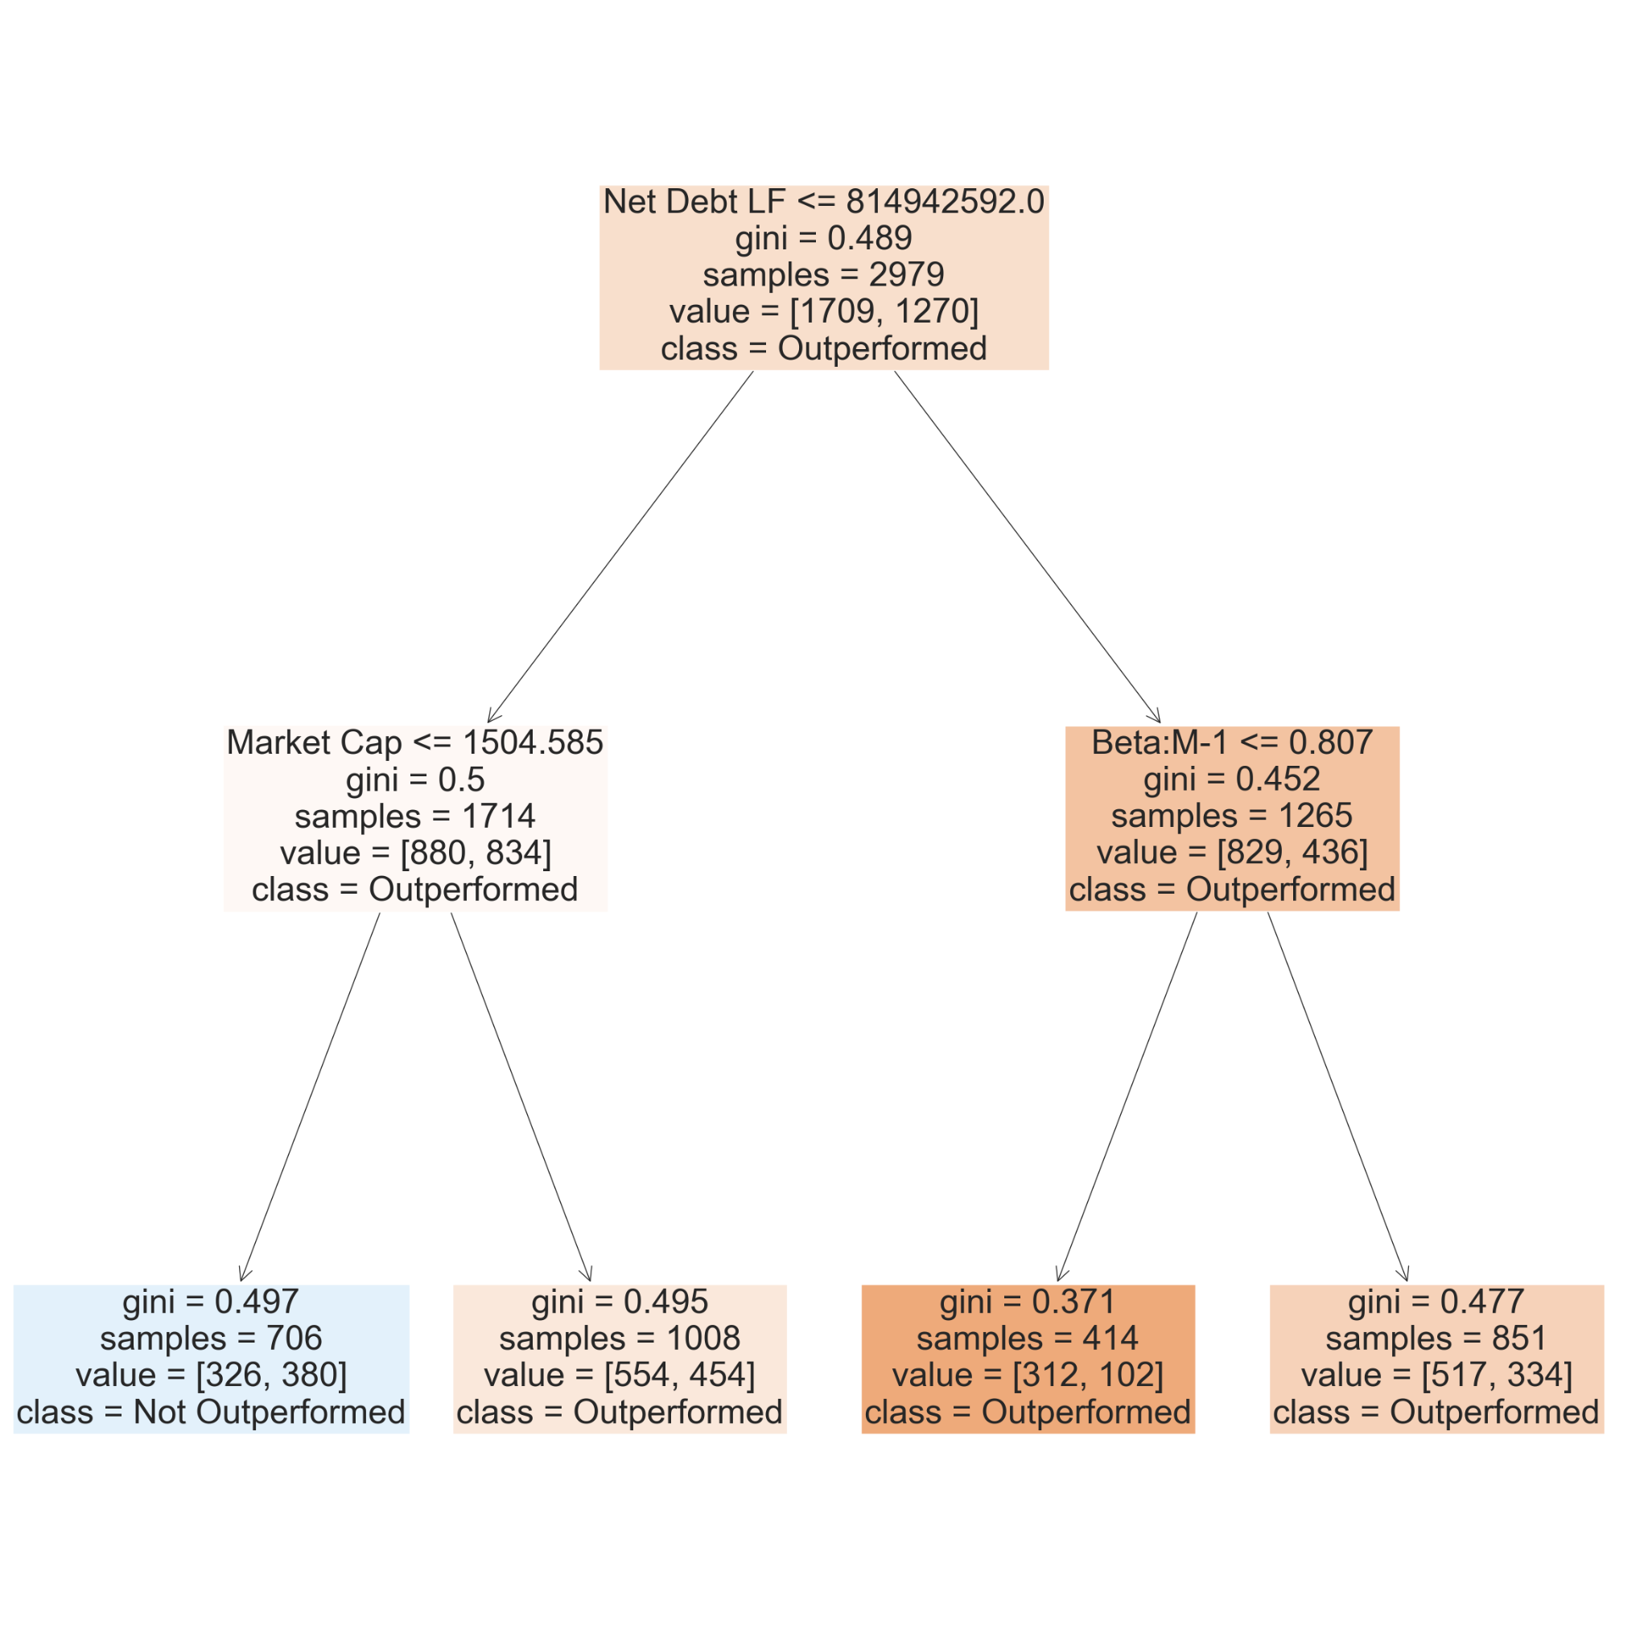
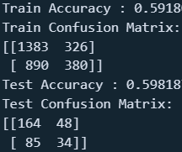
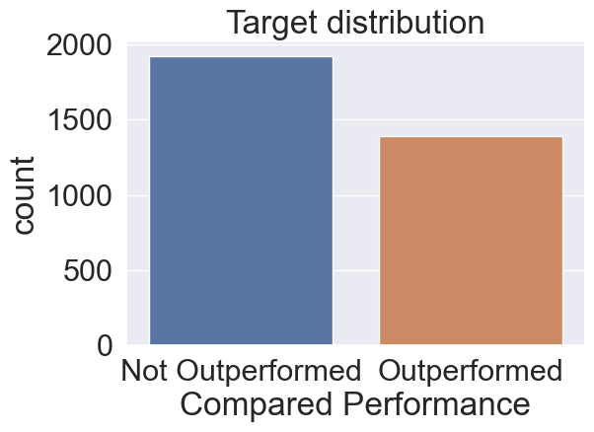
3. Machine Learning: DT concluded data

Slide 23
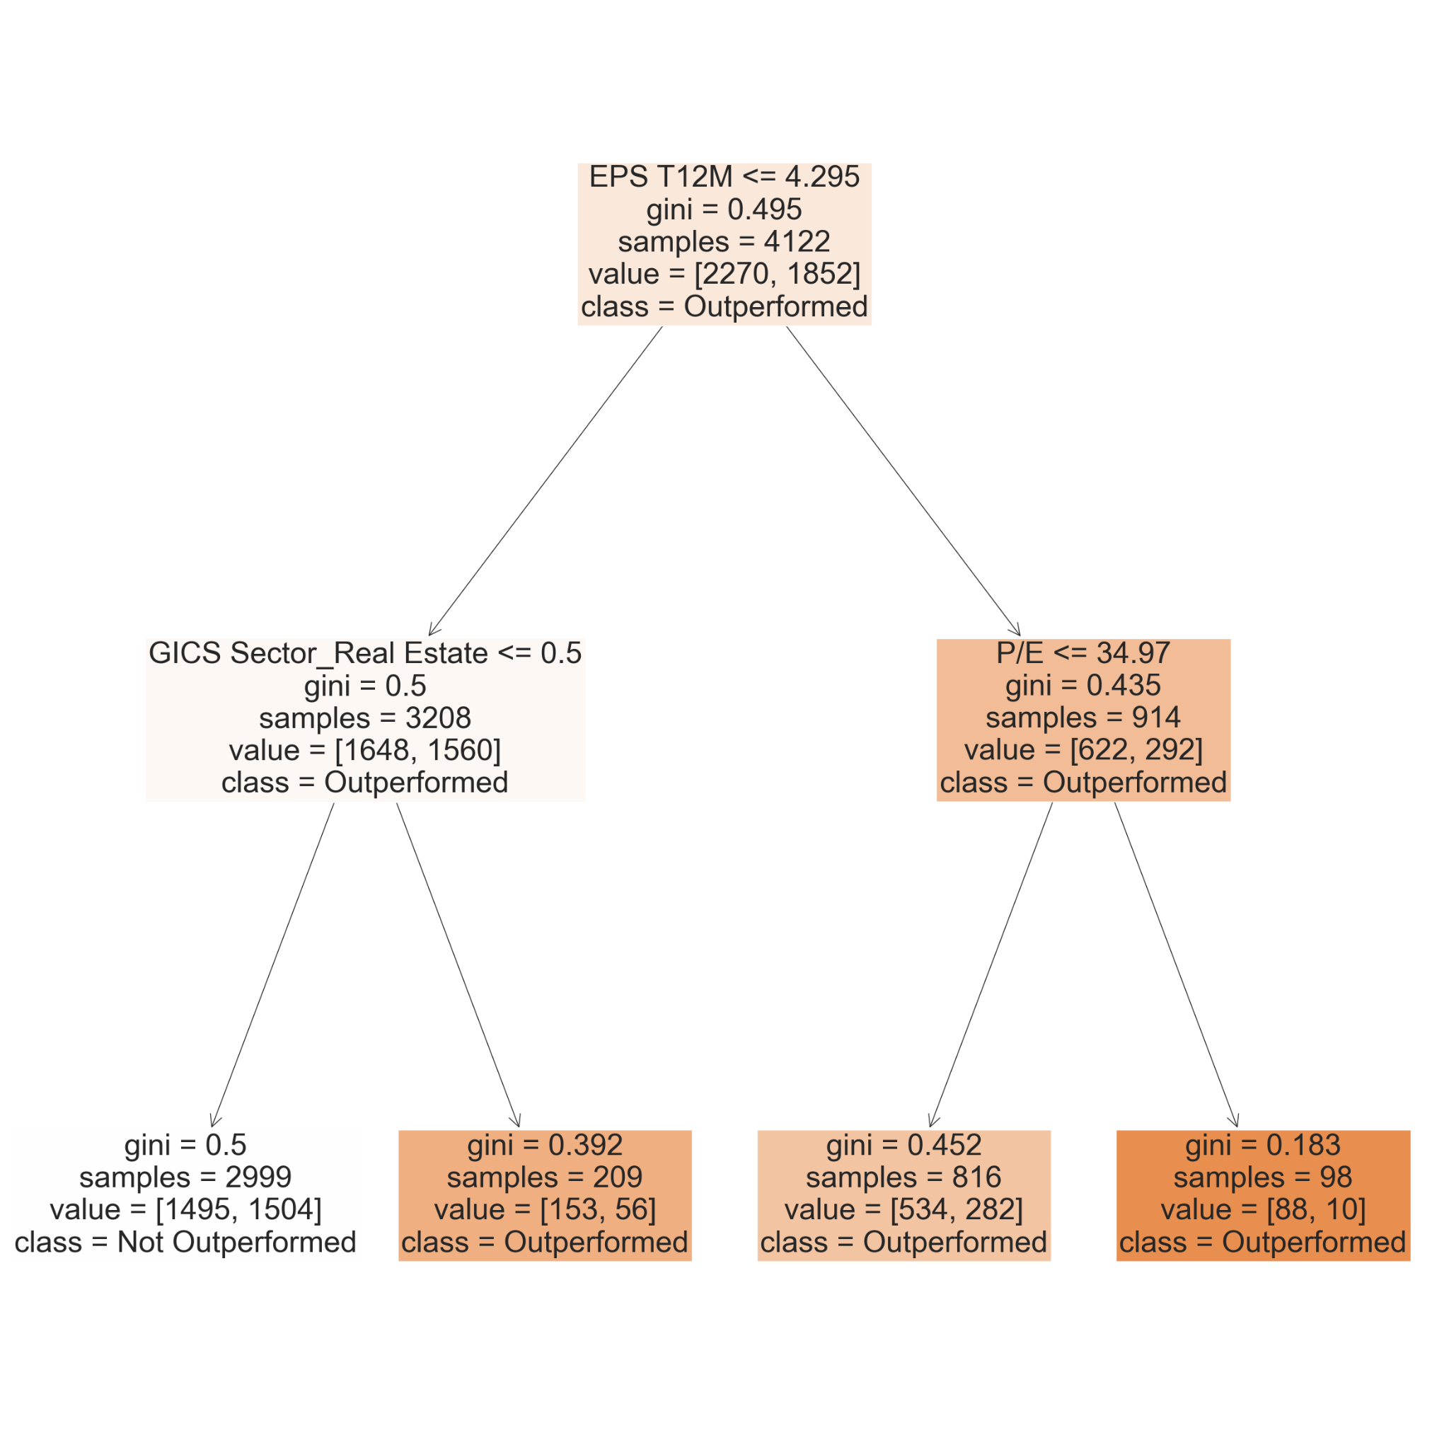
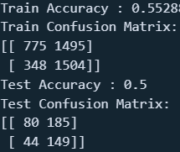
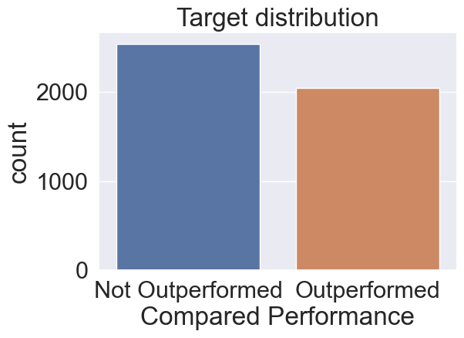
3. Machine Learning: DT all data

Slide 24
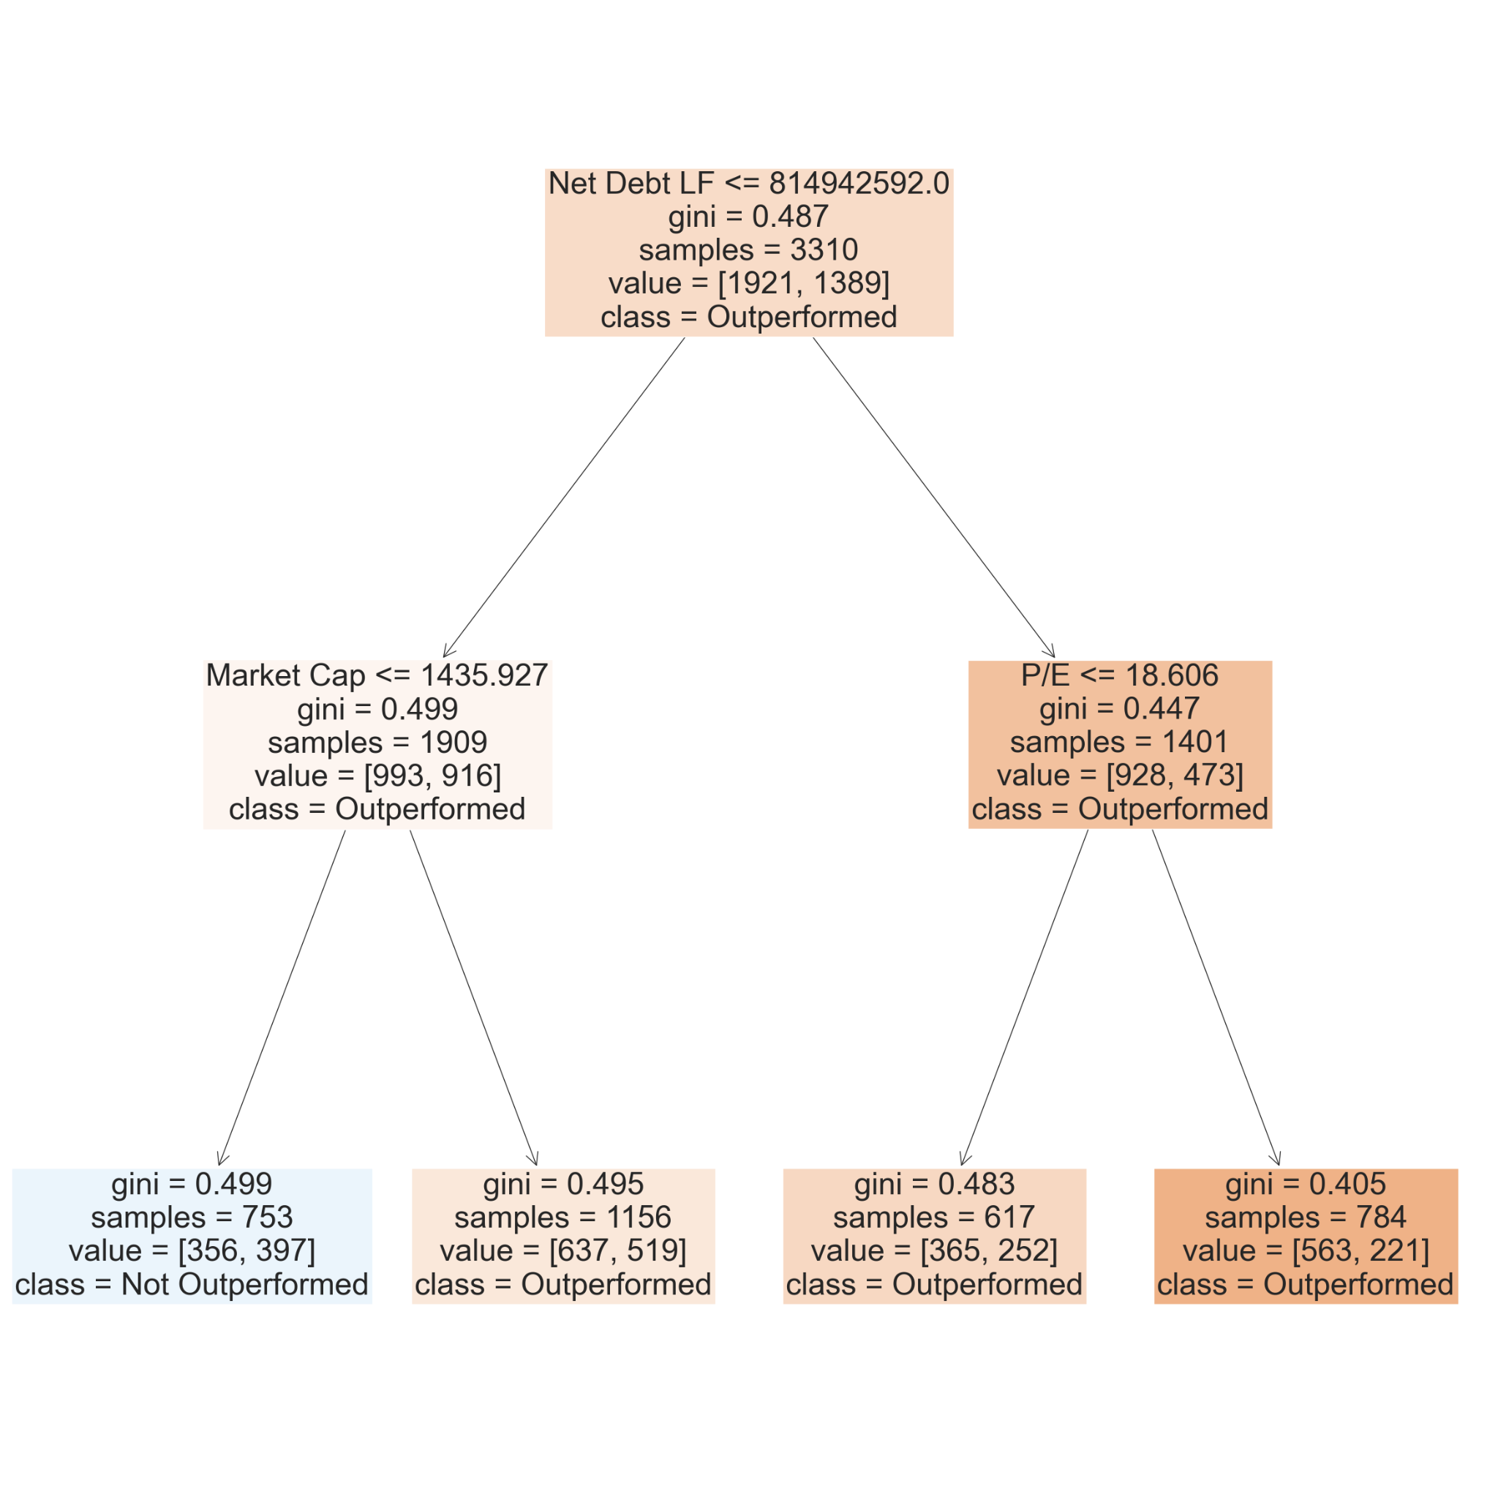
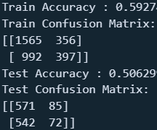
3. Machine Learning: DT concluded=train, current=test

Slide 25
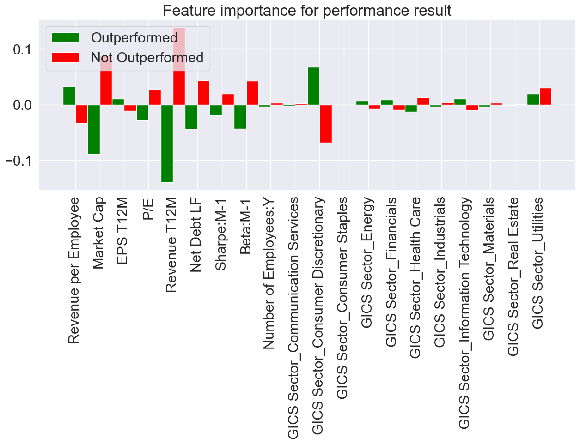
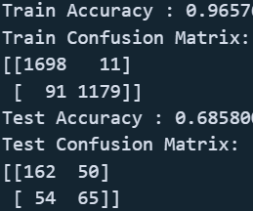
3. Machine Learning: RF concluded data
Parameters:
'bootstrap': [True]
'max_depth': [18] 'max_features': ['auto']
'max_leaf_nodes': [250] 'min_samples_leaf': [1]
'min_samples_split': [2] 'n_estimators': [50]
Notes:
best model
several more or less influential features
utilities just as good as an indicator to underperform as to outperform

Slide 26
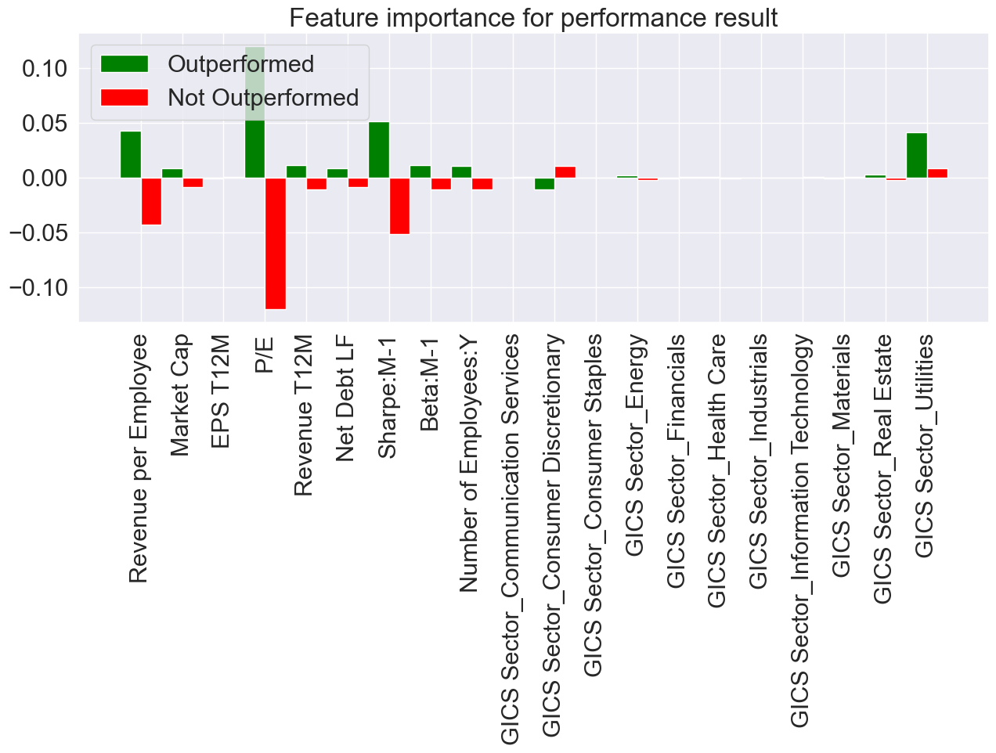
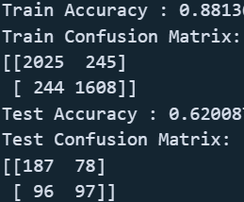
3. Machine Learning: RF all data
Parameters:
'bootstrap': [False]
'max_depth': [11]
'max_features': ['auto']
'max_leaf_nodes': [250] 'min_samples_leaf': [5]
'min_samples_split': [5] 'n_estimators': [50]
Notes:
P/E most important by far, followed by shape and revenue per employee
others quite irrelevant

Slide 27
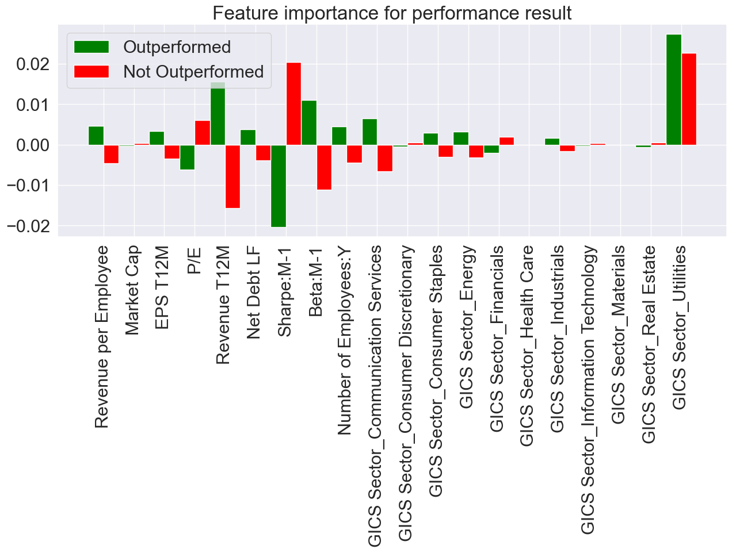
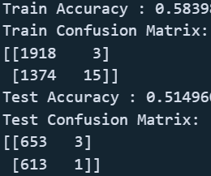
3. Machine Learning: RF concluded=train, current=test
Parameters:
'bootstrap': [True]
'max_depth': [2]
'max_features': ['auto']
'max_leaf_nodes': [250]
'min_samples_leaf': [5]
'min_samples_split': [25]
'n_estimators': [50]
Notes:
all features are quite irrelevant in total
utilities once again ambiguous
Sharpe and revenue important

Slide 28
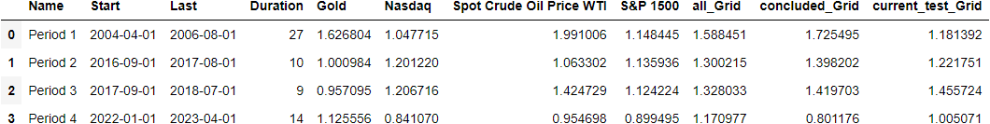
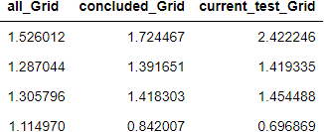
3. Machine Learning: RF predictor implementation
Notes:
current only ever identified 12 stocks as outperformed, usually less than 5

Slide 29
4. Conclusion

Slide 30
4. Conclusion
Do companies with certain feature values perform better?
Kind of, certain features are BETTER indicators whether or not a company will outperform others during a period of inflation/rising interest rates
P/E Ratio and Sharpe Ratio stand out while picking a sector is not a safe bet
Therefore, can better performing companies be determined and predicted?
Not certainly, but building a predictor based on fundamental data from past periods immensly improves the chances of outperforming the market

Slide 31
4. Conclusion
Potential further research questions:
How much more can the classifier be refined for non-binary results (label data more precisely to detect the very best performing companies)?
How do the results compare to other timeframes or are they specifically useful for periods of rising inflation rates?
Can better performing companies be explained better by some kick-off event such as an energy crisis and therefore a systematic dependency (less energy dependent companies perform better in comparison)?

Slide 32
5. Sources

Slide 33
Data Sources
Bloomberg Finance L.P.
https://www.spglobal.com/spdji/en/indices/equity/sp-composite-1500/#overview
https://fred.stlouisfed.org/series/FEDFUNDS#
https://fred.stlouisfed.org/series/CORESTICKM159SFRBATL
https://fred.stlouisfed.org/series/UNRATE
https://fred.stlouisfed.org/series/WTISPLC
https://www.investing.com/commodities/gold-historical-data

Slide 34
Scientific Sources
Bampinas, Georgios, and Theodore Panagiotidis. "Hedging inflation with individual US companies: A long-run portfolio analysis." The North American Journal of Economics and Finance 37 (2016): 374-392.
Choudhry, Taufiq. "Inflation and rates of return on stocks: evidence from high inflation countries." Journal of International Financial Markets, Institutions and Money 11.1 (2001): 75-96.
Ghosh, Dipak, et al. "Gold as an inflation hedge?." Studies in Economics and Finance 22.1 (2004): 1-25.
Salisu, Afees A., Ibrahim D. Raheem, and Umar B. Ndako. "The inflation hedging properties of gold, companies and real estate: A comparative analysis." Resources Policy 66 (2020): 101605.
Zaremba, Adam, Zaghum Umar, and Mateusz Mikutowski. "Inflation hedging with commodities: A wavelet analysis of seven centuries worth of data." Economics Letters 181 (2019): 90-94.

Slide 35
Thank you for your attention!

